Slide 1
The National FAA Safety Team Presents
Topic of the Month – August
Pre-flight & In-flight Weather Resources
<>
<>
<>
Notes:
2023/10-29-304(I)PP Original Author: John Steuernagle 01/30/2019; POC Kevin Clover AFS-850 Operations Program Manager, Office (562-888-2020) Revised by Mike Jesch FAASTeam Lead Rep. August 2022. Revised by John Steuernagle May 2024.
Presentation Note: This is the title slide for Pre-flight and In-Flight Weather Resources.
Script - We have included a script of suggested dialog with most slides. The script will always appear in a non-italic font. Presenters may read the script or modify it to suit their own presentation style. See template slides 5 and 6 for examples of a slides with script.
Presentation Instructions - (stage direction and presentation suggestions) will be preceded by a Bold header: the instructions themselves will be in Italic fonts. See slide 2, for an example of slides with Presentation Instructions only.
Program control instructions - will be in bold fonts and look like this: (Click) for building information within a slide; or this: (Next Slide) for slide advance.
Background information - Some slides may contain background information that supports the concepts presented in the program.
Background information will always appear last and will be preceded by a bold Background: identification.
The production team hope you and your audience will enjoy the show. Break a leg!
(Next Slide)

Slide 2
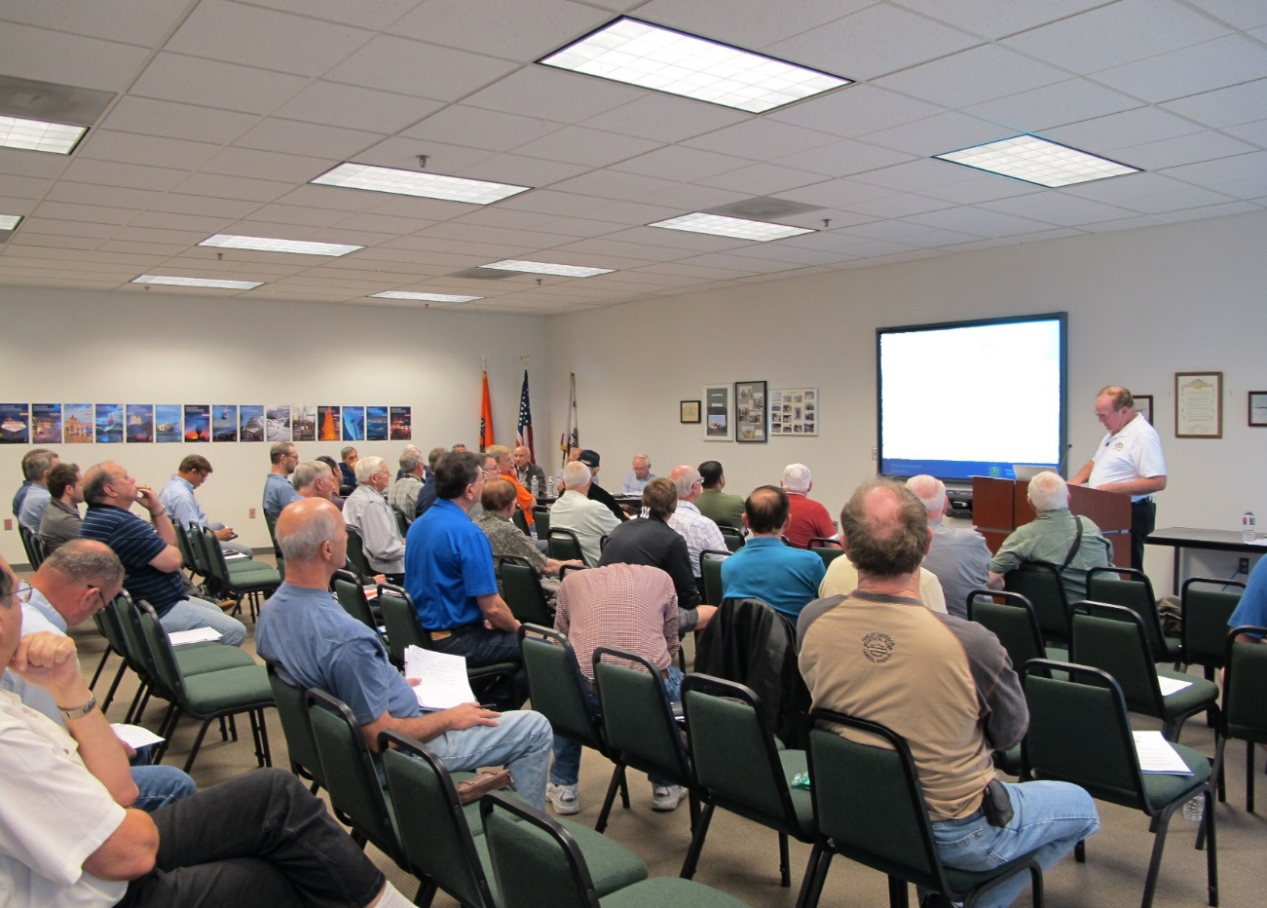

Welcome
Exits
Restrooms
Emergency Evacuation
Breaks
Phones & devices to silent or off
Sponsor Acknowledgment
Other information
Notes:
Presentation Note: Here’s where you can discuss venue logistics, acknowledge sponsors, and deliver other information you want your audience to know in the beginning.
You can add slides after this one to fit your situation.
(Next Slide)

Slide 3

Overview
*GAJSC Safety Enhancement – Weather Technology
Pre-flight weather resources
  Not a comprehensive list
  Sample of government resource
  available today
  Many third-party resources are
  also available
In-flight weather resources
  Not a comprehensive list
  Sample of resources available today
*General Aviation Joint Safety committee
Notes:
The General Aviation Joint Safety Committee is a government/industry group that looks at GA mishap experience and makes recommendations (they call them safety enhancements) for safety improvement. This program addresses their recommendation that GA pilots be apprised of advances in weather technology that can enhance the safety of flight.
In this program, we’ll discuss automated resources that are available for you to conduct a preflight briefing. We also discuss weather information resources that are available to general aviation pilots in flight.
Technology is advancing so quickly that we can’t claim our list of resources is at all comprehensive but rather a sampling of what’s available to pilots today.
Presentation Note: If you’ll be discussing additional items, add them to this list.
(Next Slide)

Slide 4
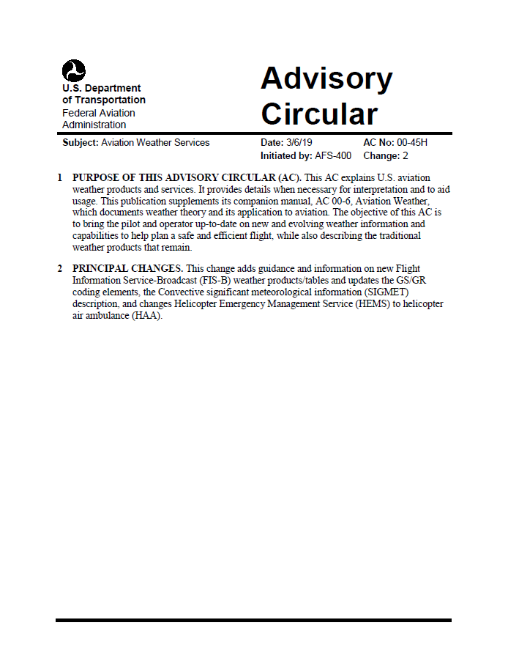
Resources
AC 00-45H Aviation Weather Services
  Comprehensive list of FAA, NWS services
  and products
  Includes FIS-B (Flight Information Service-
  Broadcast) products available through ADS-B
  in data link
Cancelled
December 2022
Notes:
Much of the information presented here was contained in FAA Advisory Circular 00-45H – Aviation Weather Services. (Click)
That publication was cancelled in 2022 so, if you have a copy lying around consider it an artifact. Aviation Weather Services information is now found in the latest edition of the Aviation Weather Handbook.
(Next Slide)

Slide 5
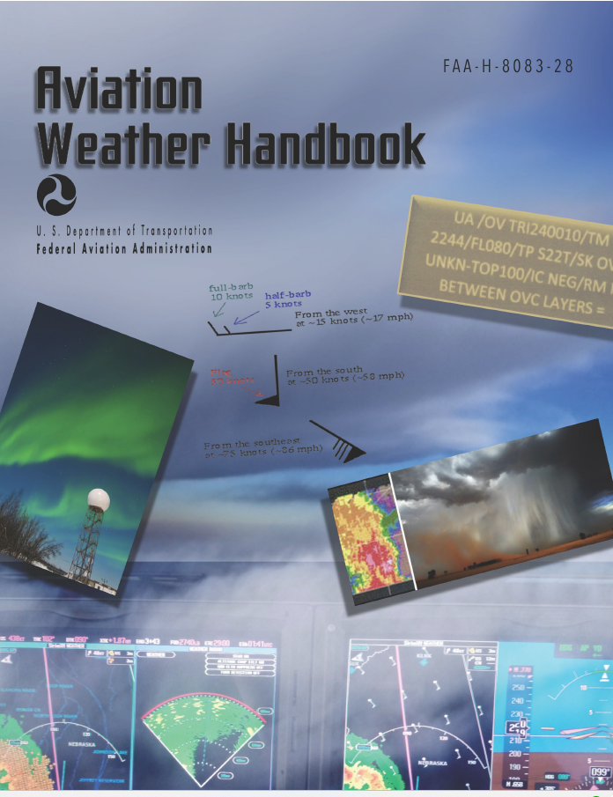

Resources
FAA-H-8083-28, Aviation Weather Handbook | ResourcesFederal Aviation Administration
Notes:
Here’s a link to the Aviation Weather Handbook – an essential component of every pilot’s library.
(Next Slide)

Slide 6
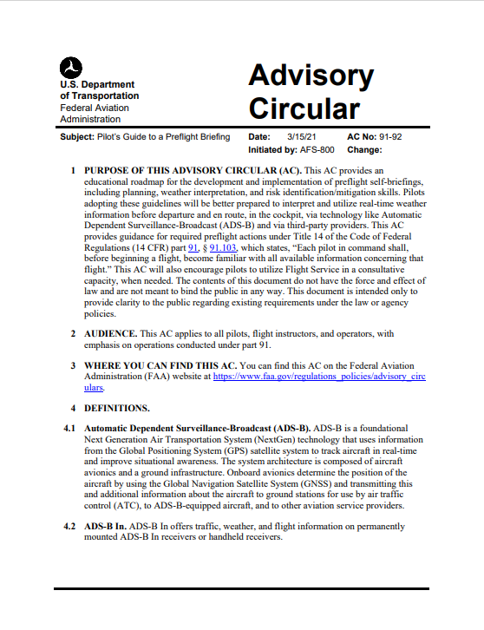
Resources
AC 91-92: Pilot’s Guide to a Preflight
Briefing
  Extensive ADS-B discussion
  Flight Service Web Services
  Self-briefing information and tips
  Single-pilot Resource Management
Notes:
We also drew heavily on AC91-92 – The Pilot’s Guide to a Preflight Briefing – released in March of 2021. This publication features extensive ADS-B information, Flight Service Web Services, Self-briefing information and tips and Single-pilot Resource Management. (Click)
We’ll list additional information resources at the end of this presentation.
(Next Slide)

Slide 7
More on AC 91-92
Encourages pilots to conduct regulatory compliant preflight self-briefings
Shows pilots how to conduct a regulatory compliant preflight self-briefing using automated resources
Assists pilots in complying with Title 14 of the Code of Federal Regulations (14 CFR) part 91, §§ 91.103 that states pilots in command shall become familiar with all available information concerning their flight before departure
Replaces FAA publications:
  General Aviation Pilot’s Guide to Preflight Weather Planning, Weather self-Briefings, and Weather Decision Making
  How to Obtain a Good Weather Briefing
Notes:
AC 91-92, offers valuable information on the conduct of regulatory compliant self briefings and it assists in 14CFR §§ 91.103 compliance.
The AC - replaces FAA publications:
- General Aviation Pilot’s Guide to Preflight Weather Planning, Weather self-Briefings, and Weather Decision Making
- How to Obtain a Good Weather Briefing
(Next Slide)

Slide 8


Weather analysis and decision making are big parts of our job.
Notes:
Weather analysis and decision making are big parts of every pilot’s job. We know the weather at our departure airport but en route weather is less certain. (Click)
And of course, we need to know if weather conditions will permit a landing at our destination.
(Next Slide)

Slide 9
Preflight to tie down
Process
Perform
Perceive
Perceive
  Gather weather information
Process
  Analyze weather information
Perform
  Make and act upon
  operational decisions
Notes:
Weather information gathering, analysis, and decision making begin with the preflight and continue throughout. While en route we need to continually: (Click)
Perceive present weather conditions and gather additional weather information from various sources. (Click)
Process weather information by comparing present weather with forecasts and by relating present and expected weather conditions to aircraft and pilot performance capabilities. (Click)
Perform by making operational decisions and acting upon them. (Click)
This process continues throughout the flight. Our perception of the results of our performance decisions further informs and refines our analysis.
(Next Slide)

Slide 10
Pre-flight Self-Briefing
Prior to every flight, pilots should gather all information vital to the nature of the flight
Using automated resources, pilots can conduct a regulatory compliant preflight briefing without contacting Flight Service
Pilots who prefer to contact Flight Service are still encouraged to conduct a self-briefing prior to calling
  Provides familiarity of meteorological and aeronautical conditions applicable to the route of flight
  Promotes a better understanding of weather information
Notes:
Regulations require that, during our pre-flight planning, we gather all pertinent information with regard to each flight.
We can use automated weather information resources to gather weather information without contacting Flight Service
Pilot can still contact Flight Service, but they are highly encouraged to conduct a self-briefing prior to the call. That way they’ll have
a good idea and understanding of weather conditions before speaking with a briefer.
(Next Slide)

Slide 11
Pre-flight Know Before You Go
1) Adverse Conditions | Weather advisories (SIGMETs, AIRMETs, Convective SIGMETs, Center Weather Advisories, Aviation Watch Notification Messages) NOTAMs (airport/runway closures, TFRs, etc.) IFR conditions, low-level windshear, thunderstorms, reported icing, frontal zones
2) Synopsis | Weather systems and/or air masses
3) Current Conditions | Current observations (e.g., METARs, PIREPs) for departure, en route, and destination Satellite and radar imagery
4) Forecast Conditions | Forecast information (departure, en route, and destination)
5) Winds Aloft | Winds aloft forecast (interpolate between levels and stations) Temperature at proposed altitude
6) Notices to Airmen (NOTAM) | Departure, en route, and destination
7) Restricted or Special Use Airspace | Prohibited Areas P-40, P-56, and the Special Flight Rules Area (SFRA) for Washington, DC
8) ATC Delays | ATC delays and/or flow control advisories
Notes:
Flight Service uses this general list of elements for providing Standard Weather Briefings.
It is recommended that this list be used when conducting a preflight self-briefing using automated resources.
Using this list of elements when conducting a preflight self-briefing regardless of the automated resource will assist a pilot in complying with Title 14 of the Code of Federal Regulations (14 CFR) Part 91.103
There are also interactive graphics (e.g. GFA or 1800wxbrief.com Interactive map) available that depict some of these elements to assist in understanding what information is applicate to the route of flight.
(Next Slide)

Slide 12
Sample Pre-flight Self-Briefing Resources
1800wxbrief.com | Leidos Flight Service – FAA Contract Vendor
avcams.faa.gov | Alaska and Canada
aviationweather.gov | NOAA/Government Web Site for aviation weather
Fly.faa.gov/flyfaa/usmap.jsp | FAA Flight Delay Information
nhc.noaa.gov | National Hurricane Center (HNC)
notams.aim.faa.gov/notamSearch | Federal NOTAM System (FNS)
spc.noaa.gov | NOAA Storm Prediction Center
ssd.noaa.gov/VAAC/vaac.html | Volcanic Ash Advisory Centers (VAAC)
sua.faa.gov | Special Use Airspace
tfr.faa.gov/tfr2/list.html | Temporary Flight Restrictions
weather.gov | National Weather Service Forecast Office
weather.gov/aawu | Alaska Aviation Weather Unit (AAWU)
weather.gov/hfo | National Weather Service Forecast Office Honolulu, HI
wpc.ncep.noaa.gov | Weather Prediction Center
Notes:
Listed are government resources, there are also third-party automated resources that may be used for conducting pre-flight self-briefings
FAQ on using automated preflight resources. You may get some of the questions listed below. If so refer to the answer listed.
Q1: Does my self-briefing need to be recorded or documented by the automation sites(s) I use?
A1: There is no requirement for a self-brief to be recorded
If you prefer to have your self-briefing preparation be recorded, consider invoking the Standard Briefing functionality on 1800wxbrief.com; third-party applications may also offer a recorded briefing functionality
Q2: I like the Graphical tools (GFA, Interactive Maps) when conducting preflight planning. Do I still need to use the “Standard Briefing” functionality on the planning website or app that provides a full textual briefing?
A2: Full textual (aka Standard Briefing) functionality is not required to be invoked
The goal is to conduct a comprehensive preflight self-briefing; if you have done this (i.e., covered all the checklist items) using the graphical tools, you do not need to invoke a full textual briefing
However, the Standard Briefing functionality is a good idea as a double check that you have not missed something in your own workflow
Q3: If I conduct a self-brief and still decide to call Flight Service, will they know what I have done online?
A3: YES, if you have used 1800wxbrief.com and requested a standard briefing
YES, if you have used a third-party application that links to your 1800wxbrief.com account and uses an approved standard briefing product (check with your particular third-party vendor)
NO, if you have used just the graphical functionality on 1800wxbrief.com, AWC, or third-party sites
If you plan to call Flight Service, then invoking the Standard Briefing functionality from 1800wxbrief.com (or a third-party application that shares your 1800wxbrief.com credentials) will allow the Specialist to see your briefing details and save you time
(Next Slide)

Slide 13
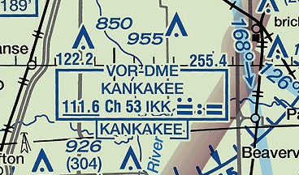
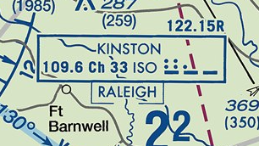
In-flight Weather Sources
Flight Service (FSS) en route weather
Frequencies depicted on VOR data block
    FSS transmits & receives on 122.2 (VHF) and 255.4 (UHF)
    FSS transmits and receives on 122.6 or receives on 122.1 & transmits on 108.8 (VOR)
Notes:
Let’s begin with FAA Flight Service. FSS stations provide en route weather via voice communication in a couple of different ways. In this example, aircraft flying near the Kankakee VOR can contact Flight Service on 122.2 Mhz. Aircraft equipped with UHF Comm radios can contact FSS on 255.4 Mhz. (Click)
Here Flight Service can receive on 122.1 Mhz. and transmit over the Kinston VOR on 109.6 Mhz. If you choose the VOR communication option, be sure to enable voice on your VOR receiver and adjust the audio volume so you can hear the FSS transmissions.
(Next Slide)

Slide 14


In-flight Weather Service Products – Radio or Datalink
Near Real Time or older | Forecasts old news
METARs – Surface Observations | Graphical Forecasts for Aviation (GFA)
SPECIs – Special METAR Reports | Terminal Aerodrome Forecasts - TAFs
SIGMETs (WSs) – Non-convective weather hazards to all aircraft | Winds & Temperatures Aloft
Convective SIGMETs (WSTs) – Convective weather hazards to all aircraft
AIRMETS (WAs) – Weather hazards to light aircraft
PIREPs - Pilot reports of flight conditions
NOTAMs – Notices to Airmen
Compare forecasts to real time observations to get the best weather picture.
Gold Seal
Notes:
Here are some of the products available for en route access. You may receive this information via radio (flight Service) or via data link. More about data link later.
Whenever you access weather information it’s important to know how old that information is. Some of the products in the left hand column could be more than an hour old when you receive them. Others may be quite recent. That’s why it’s important to note the times when observations were taken and/or the product validity time span.
Products in the right hand column will be older than those in the left. (Click)
Forecasts work best when you compare them with more current weather observations. That way you can see if weather is developing earlier or later than the forecast schedule.
PIREPs – Pilots are the best resource for reporting inflight weather conditions and confirming forecasts are correct or not.
(Next Slide)

Slide 15
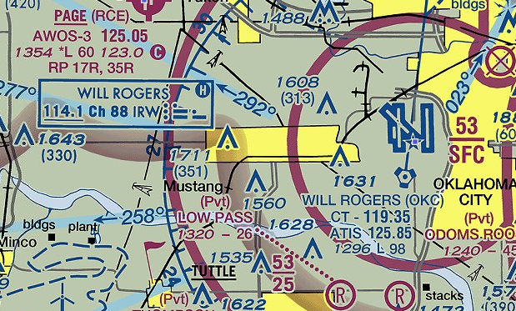
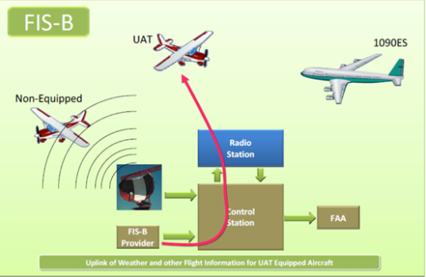
In-flight Weather Sources
Hazardous in-flight Weather Advisory Service (HIWAS)
Flight Information Services-Broadcast (FIS-B)
Notes:
The letter H in a VOR data block indicates a couple of things:
the ability to receive HIWAS (Hazardous in-flight Weather Advisory broadcasts. As the name implies, these were pre-recorded advisories of hazardous weather conditions. (Click)
It also indicates that you’re consulting an out dated chart because HIWAS was decommissioned in January of 2020. (Click)
Also in January most aircraft are required to be equipped with ADS-B out. For those of us who are equipped with ADS-B In, FAA is providing an impressive set of weather information products collectively known as Flight Information Services – Broadcast or FIS-B.
(Next Slide)

Slide 16
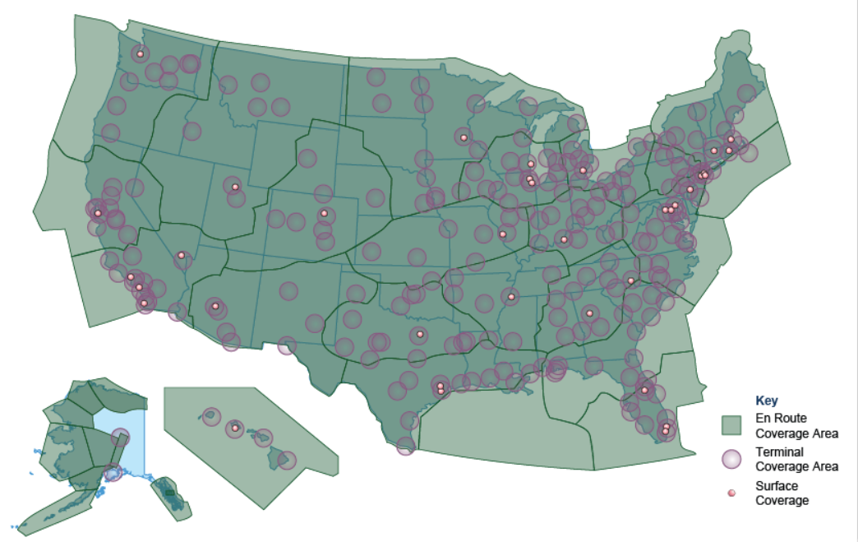
ADS-B – In Applications
Automatic Dependent Surveillance – Rebroadcast (ADS-R)
Traffic Information Services - Broadcast (TIS-B)
Flight Information Services - Broadcast (FIS-B)
Notes:
Although ADS-B In equipment is not required, there are some compelling reasons why pilots are considering installing it. As you can see from the coverage map, en route ADS-B In service is available throughout the country. With ADS-B In you get a suite of traffic, weather, and flight information products. Let’s take a look at how it works.
(Next Slide)

Slide 17
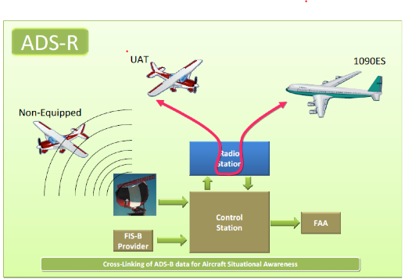
ADS-R
UAT ADS-B In aircraft receive UAT ADS-B out traffic directly
ADS-R relays ADS-B Out Information to ADS-B In-equipped aircraft
Notes:
UAT equipped ADS-B In aircraft receive traffic information directly from UAT ADS-B out aircraft. (Click)
ADS-R rebroadcasts traffic information derived from UAT and 1090 Extended Squitter positions so that even though the two systems don’t exchange information directly, traffic information is available to both.
There’s also a way for ADS-B in users to see aircraft that are not ADS-B Out equipped.
(Next Slide)

Slide 18
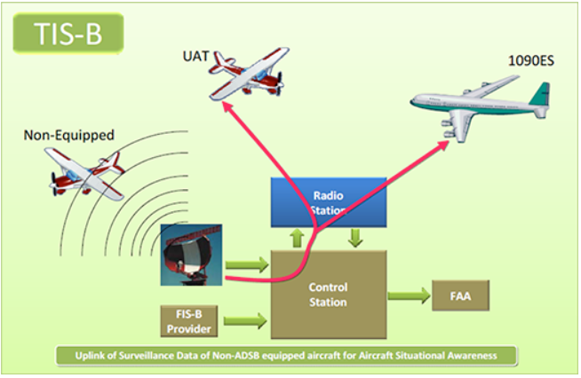
TIS-B
Available to ADS-B In aircraft at and below 24,000 feet
Positional data collected from all aircraft is transmitted to ADS-B In aircraft
Notes:
The ADS-B system transmits TIS-B data on both links to equipped aircraft flying within coverage. TIS-B uses data from ADS-B, radar, Wide Area Multilateration (WAM), and surface multilateration systems like ASDE-X to create accurate near-real-time position reports.
In order to receive TIS-B information you must be ADS-B In equipped, within coverage of an ADS-B ground station and an FAA radar or multilateration system.
Background: Multilateration systems are employed to provide surveillance outside of radar coverage.
Wide Area Multilateration (WAM) is comprised of a network of relatively small sensors that can be deployed in areas that are problematic for radar installations. WAM capabilities an be combined within a set of ADS-B ground stations.
Surface Multilateration consists of sensors deployed on airports. The data provided by these sensors is integrated with airport surveillance radar and ADS-B sensor data to create an accurate picture of ground traffic on the airport. The equipment and sensors is collectively known as Airport Surface Detection Equipment (ASDE-X)
(Next Slide)

Slide 19
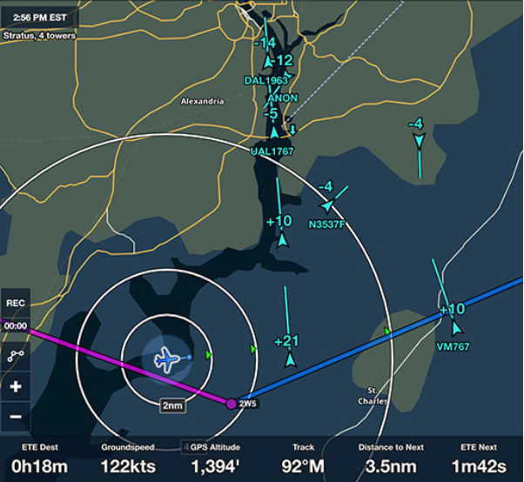
Caution
ADS-B traffic picture may
not be complete
Good adjunct to visual scan but…
We still need to look
outside for traffic.
Notes:
ADS-B In is not guaranteed to display all traffic in a given area. It’s a great situational awareness and collision avoidance tool but it’s also a compelling distraction. We still need to look outside our windows.
(Next Slide)

Slide 20
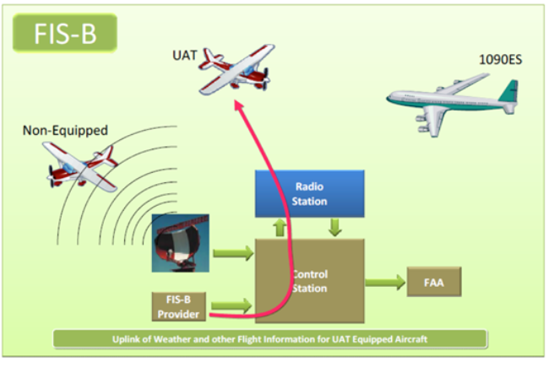
FIS-B
Available to ADS-B UAT equipped aircraft
System broadcasts aeronautical information products from the FAA and weather products from the National Weather Service
Notes:
FIS-B information is available to UAT (Universal Access Transceiver) equipped aircraft only. The system broadcasts aeronautical information products from the FAA and weather products from the National Weather Service.
(Next Slide)

Slide 21
FIS-B Products
AIRMETs | TAFs
Convective SIGMETs | Amended TAFs
SIGMETS | Winds & Temperature Aloft
METARS | Lightning
SPECIs | Turbulence
National NEXRAD | Icing
Regional NEXRAD | Cloud Tops
D-NOTAMs | Graphical AIRMETs
FDC-NOTAMs | Center Weather Advisories
PIREPS | TIS-B Service Status
Special Use Airspace (SUA) Status
Notes:
Here’s a list of text and graphical FIS-B products – available free of charge to ADS-B In users. As you can see – it’s quite extensive and more products may be added in the future.
(Next Slide)

Slide 22
In-flight Weather Sources
Automated Terminal Information Service (ATIS)
Notes:
We’re all familiar with Automated Terminal Information Service available at most towered airports. ATIS provides basic weather and runway information but what about non-towered airports?
(Next Slide)

Slide 23
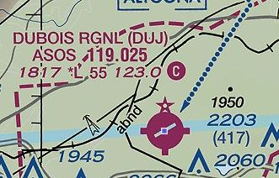
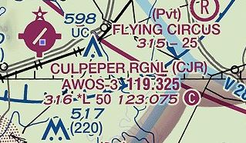
In-flight Weather Sources
Automated Surface Observing System (ASOS)
Automated Weather Observing System (AWOS)
Notes:
Many smaller airports are served by ASOS or AWOS automated weather observing systems. In fact, most of the weather data used to produce aviation weather reports and forecasts is now gathered by automated systems. These systems are constantly updating weather observations and averaging the data to give an accurate picture of present conditions. There are about one thousand ASOS and even more AWOS systems deployed throughout the United States.
(Next Slide)

Slide 24
ASOS Information
METAR Element | Information Provided
Wind Direction, Speed, & Character | Tens of degrees – Knots, Gusts
Visibility | Up to & including 10 statute miles
Runway Visual Range (RVR) | At selected sites
Basic present weather | Type and intensity
Obstructions to vision | Fog, mist, haze, & freezing fog
Sky condition | Cloud height and amount to 12,000 Ft. AGL CLR, FEW, SCT, BKN, OVC
Ambient & Dew point Temperatures | Degrees Celsius
Pressure | Altimeter Setting In. Hg.
Remarks | Automated, Manual, & Plain Language – depending on service level
Notes:
Here’s a chart of what’s available from an ASOS installation. At some locations information may be augmented by human observers.
Presentation note: Take a minute or so to discuss the information provided by ASOS, then:
(Next Slide)

Slide 25
AWOS Information
AWOS Type | Information Provided
AWOS-A | Altimeter Setting
AWOS-AV | Altimeter Setting & Visibility
AWOS-1 | Altimeter Setting, Wind speed & direction, Temperature, Dew Point, & Density Altitude
AWOS-2 | AWOS-1 plus Visibility
AWOS-3 | AWOS-2 plus Cloud & Ceiling Data
AWOS-3P | AWOS-3 plus Precipitation Discriminator
AWOS-3PT | AWOS-3P plus Thunderstorm/Lightning
AWOS-3T | AWOS-3 plus Thunderstorm/Lightning
AWOS-4 | AWOS-3 plus precipitation type and accumulation, freezing, thunderstorm, & runway surface information
Notes:
As you can see there is a wide range of information available from AWOS depending on the type of equipment installed. (Click)
Most of the AWOS installations are a variation of AWOS-3 so you’ll have Altimeter Setting, Wind, Temperature (older installations may report in degrees Fahrenheit), Dew Point, Density Altitude, Cloud and Ceiling data. Newer installations may add precipitation type and thunderstorm/lightning information.
(Next Slide)

Slide 26
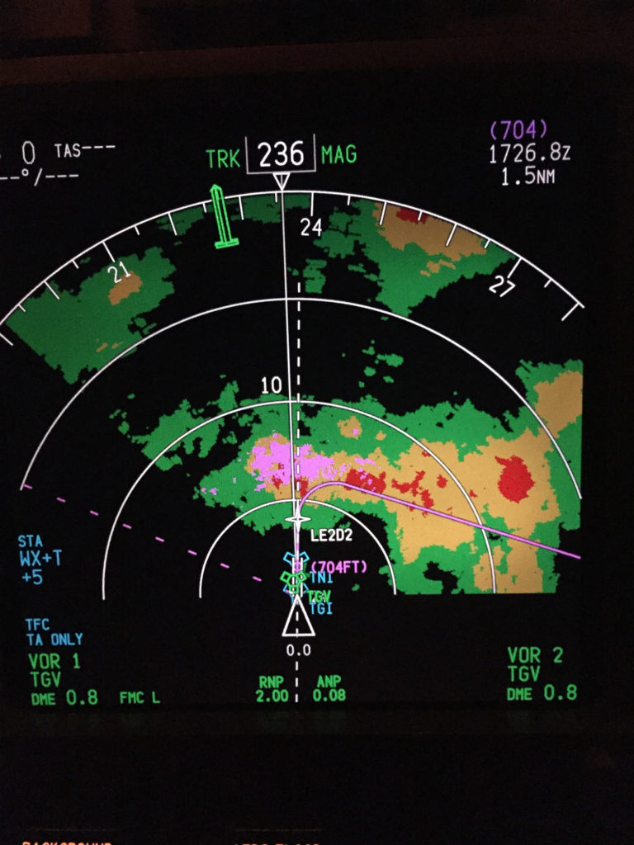
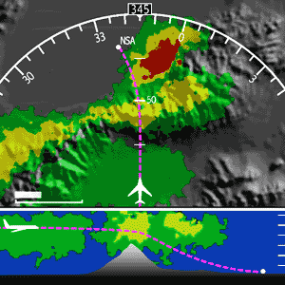
Airborne Weather Radar
Notes:
For those of us who can afford it, Airborne Weather Radar is a very useful information source. It does require interpretation though and there are some limitations to consider.
(Next Slide)

Slide 27
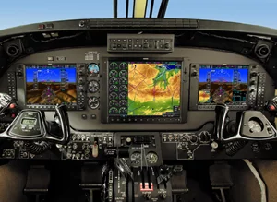
Airborne Weather Radar
Real Time
May not show all precipitation
Good for tactical avoidance
New users should seek instruction
Notes:
Airborne radar looks at precipitation and pilots know that the heavier the precipitation – the greater the associated turbulence will be. Because radar returns are immediate it’s a good choice for tactical weather avoidance. Heavy precipitation can mask additional precipitation behind it so it’s best to find wide clear areas so you can get a good picture of what’s beyond the radar return.
If you’re a new radar user be sure to get some instruction on operation and interpretation before you base tactical decisions on radar information.
(Next Slide)

Slide 28
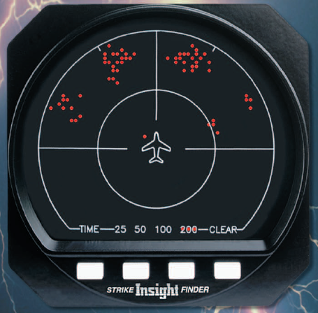
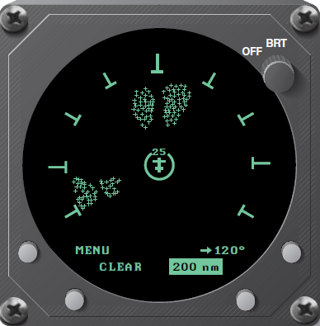
Strike Finder & Storm Scope
Real Time
Doesn’t show precipitation
Good for tactical avoidance
Instruction recommended for new users
Notes:
Another real time solution is lightning detection equipment. Although it doesn’t show precipitation it does indicate lightning strikes that accompany convective weather. Some installations integrate radar and storm scope information on a multi-function display.
As with radar, instruction is highly recommended for new users.
(Next Slide)

Slide 29
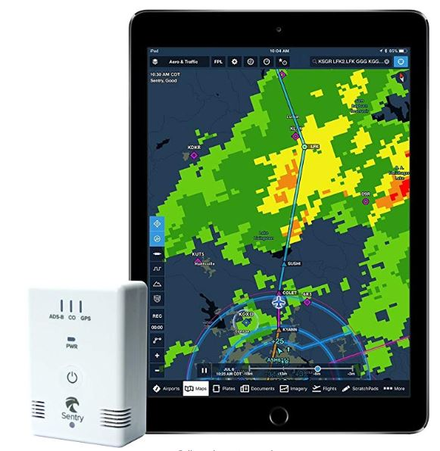
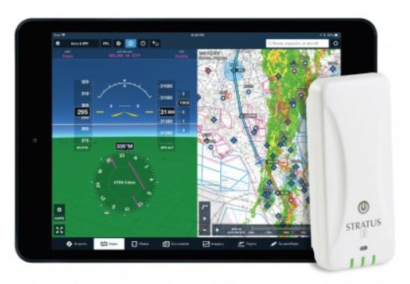
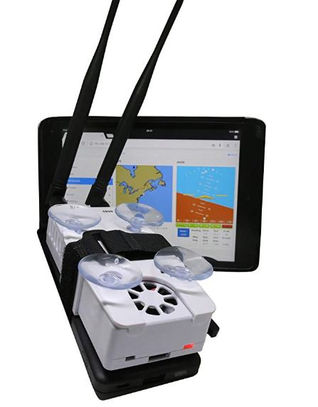
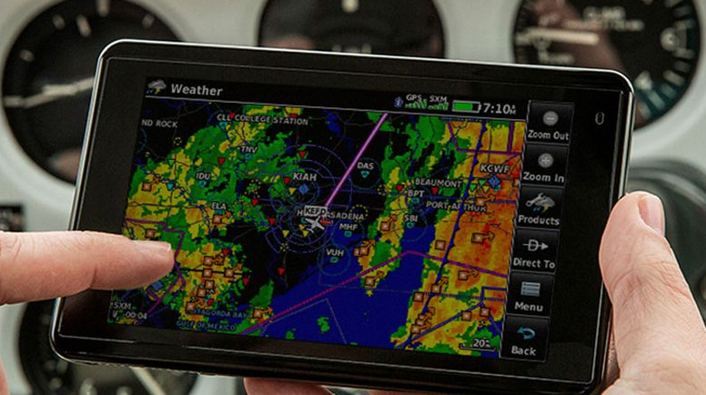
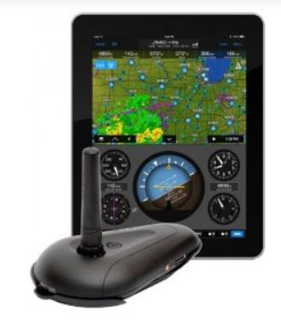

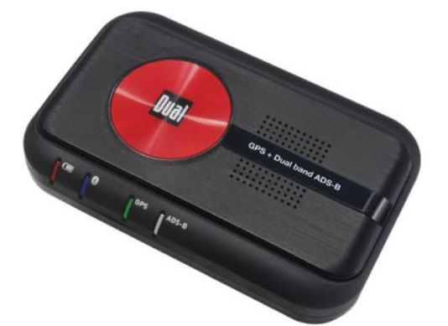
Portable ADS-B Receivers
Notes:
If you don’t want to equip with a panel-mounted ADS-B In, there are many portable ADS-B Receivers to choose from. These receivers can transmit text and graphics to a variety of portable devices and displays. One caution here – you’ll need to have sufficient battery capacity or auxiliary power available to power receivers and displays for the planned duration of your flight and any delays or diversions that may occur.
(Next Slide)

Slide 30
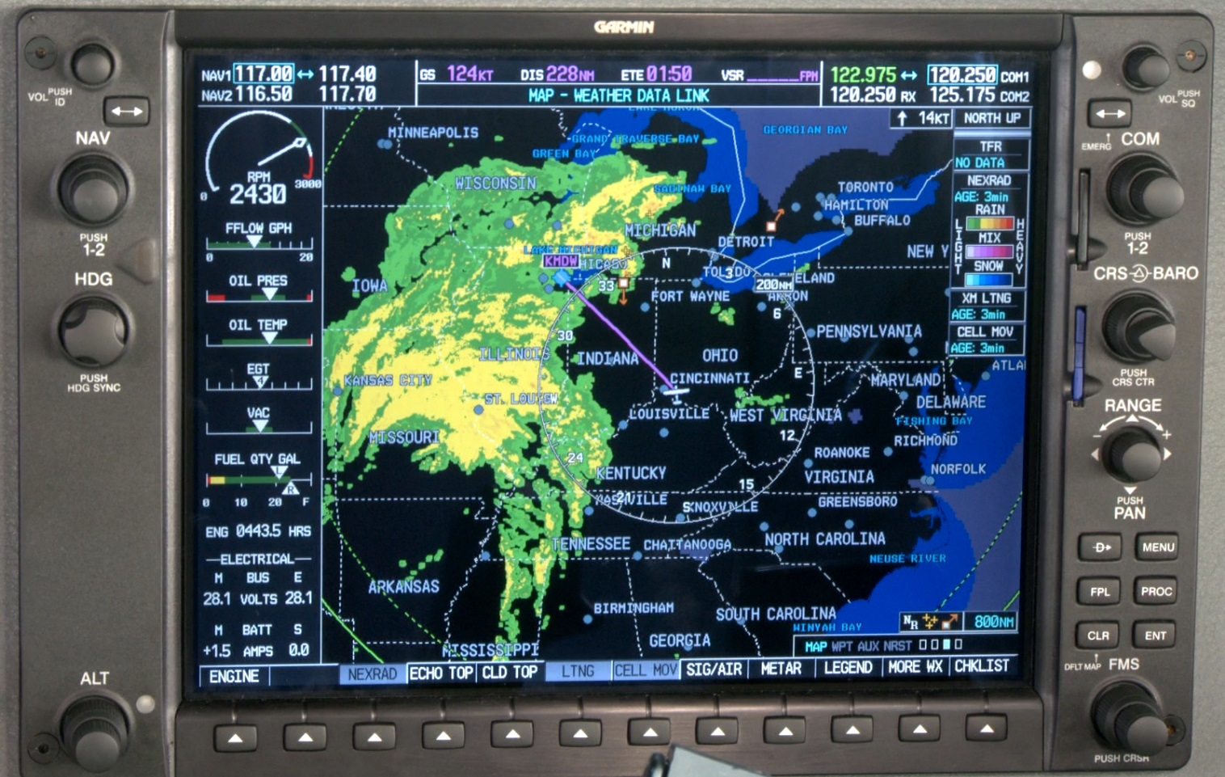
XM Weather
Near Real Time
  2.5 Minute update
  Look for time stamp
Good for strategic planning
Notes:
XM Radio is a subscription service that provides test, graphical, and audio information to en route users. XM Weather imagery is processed in near real time – usually at two and a half-minute intervals. But the imagery information could be older so, as with any weather information, be sure to check the time that the graphic data was collected.
Next, let’s take a look at how weather imagery compares with real life.
(Next Slide)

Slide 31
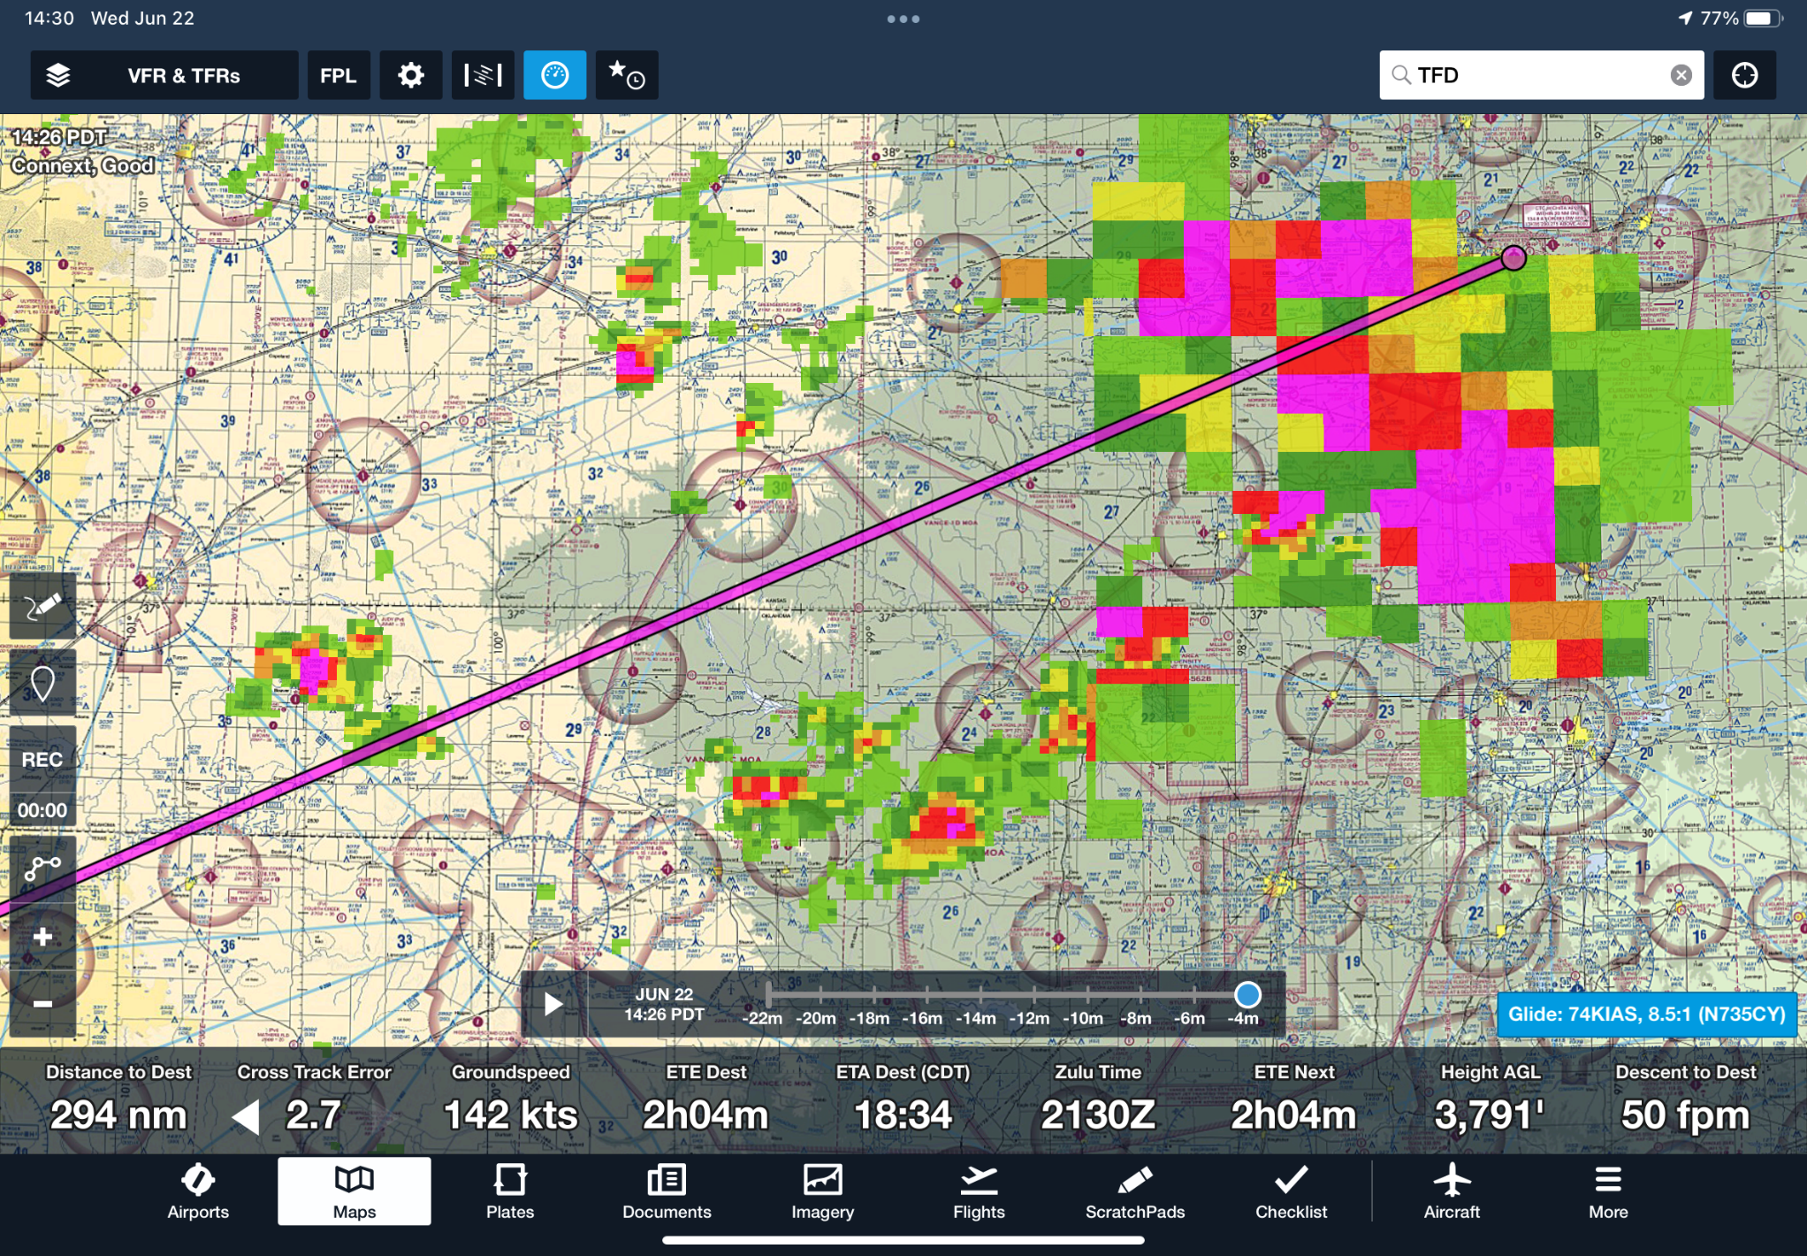
Onboard versus IRL (In Real Life)
Notes:
In ForeFlight, you get little control over what radar images you see. It simultaneously shows both Regional – nearer to the aircraft – and CONUS – more distant. You can tell by the increased resolution nearer to the aircraft.
(Next Slide)

Slide 32
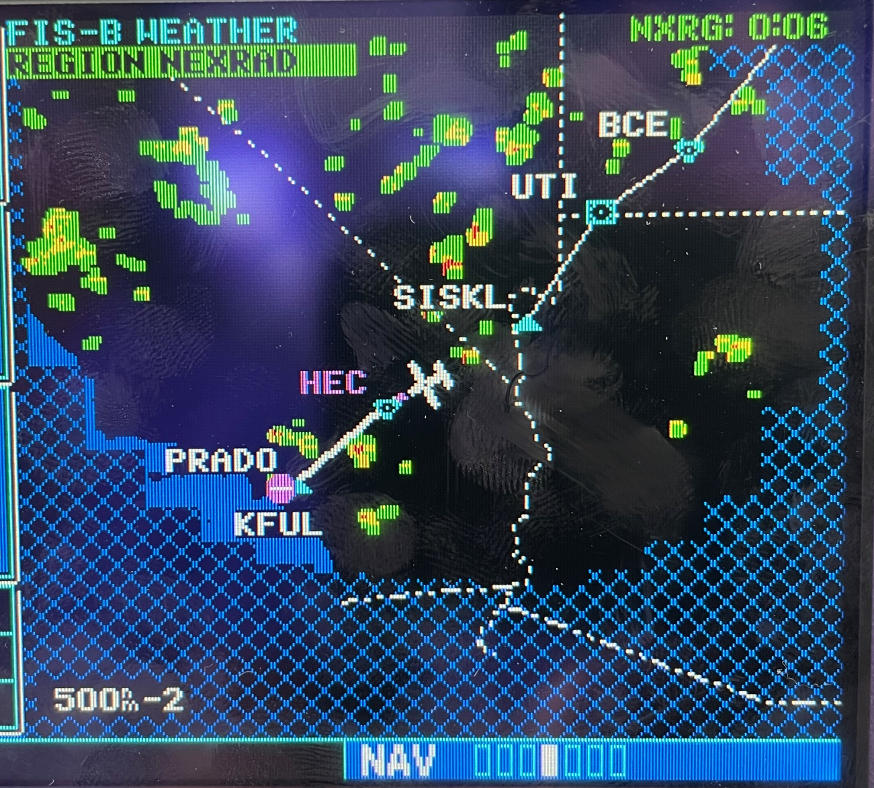
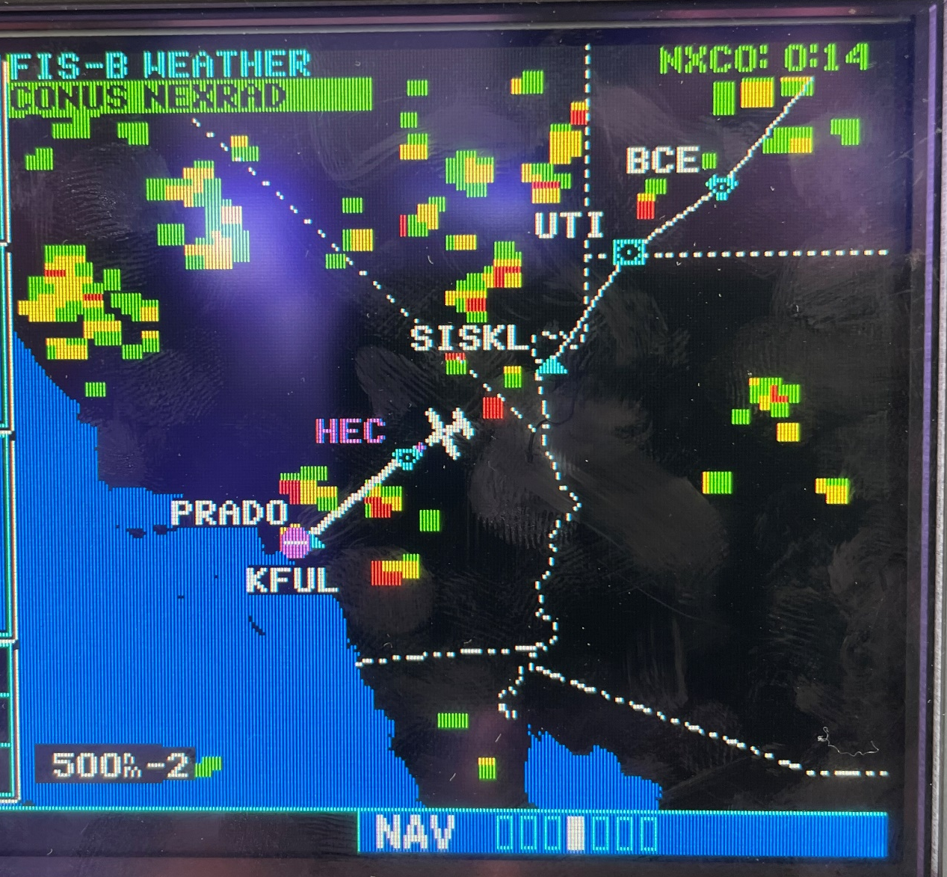
Onboard versus IRL
Notes:
This clearly illustrates the difference between Regional and CONUS Nexrad data. The hatched area is beyond the range of the regional. Better resolution, but more limited range. CONUS is better range, but lower resolution. Also note the difference in age of the newest data, 6 minutes old versus 14 minutes old. Keep in mind, this is how long ago the data was received by the device; not the time the data was gathered nor the time the image was created.
(Next Slide)

Slide 33
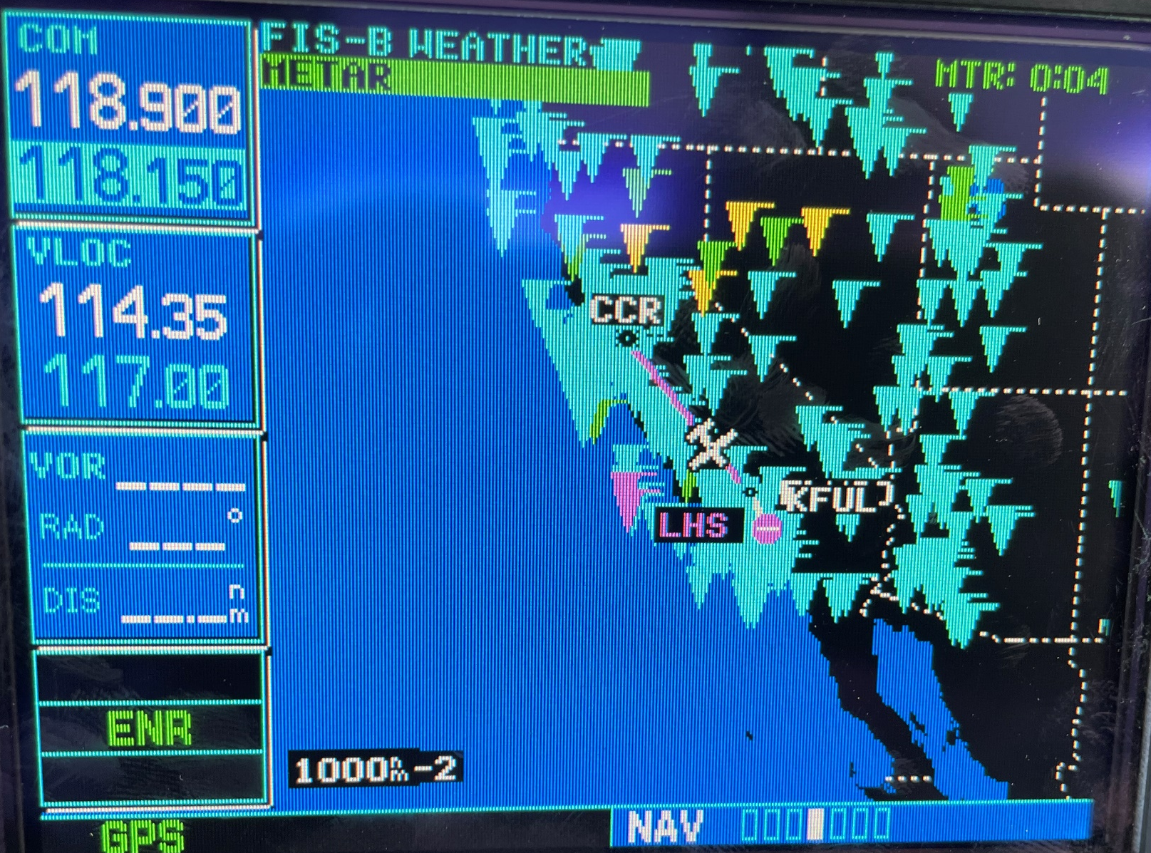
Onboard versus IRL
Notes:
This is the graphical METAR display on the GNS530W with FIS-B data received through a GTX345 transponder. Flags are color coded to indicate the current weather.
(Next Slide)

Slide 34
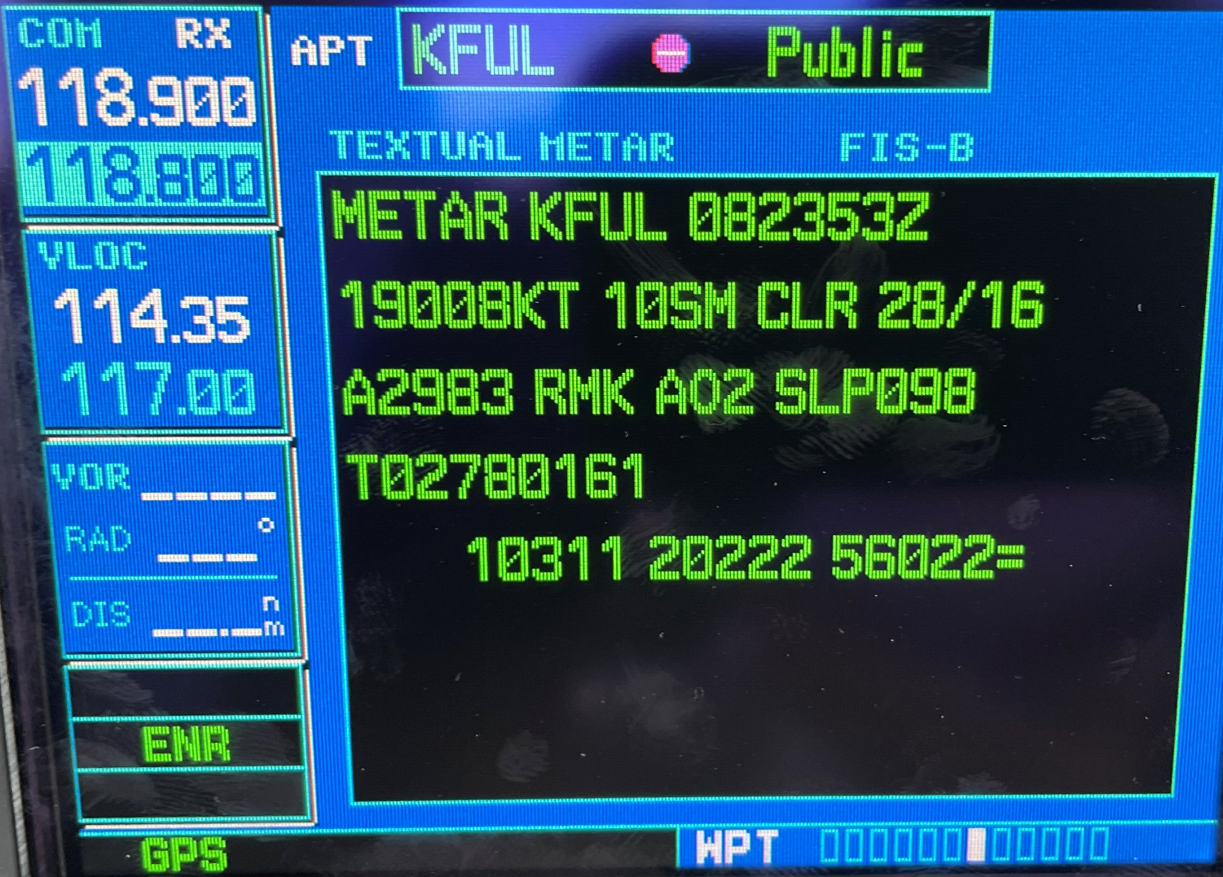
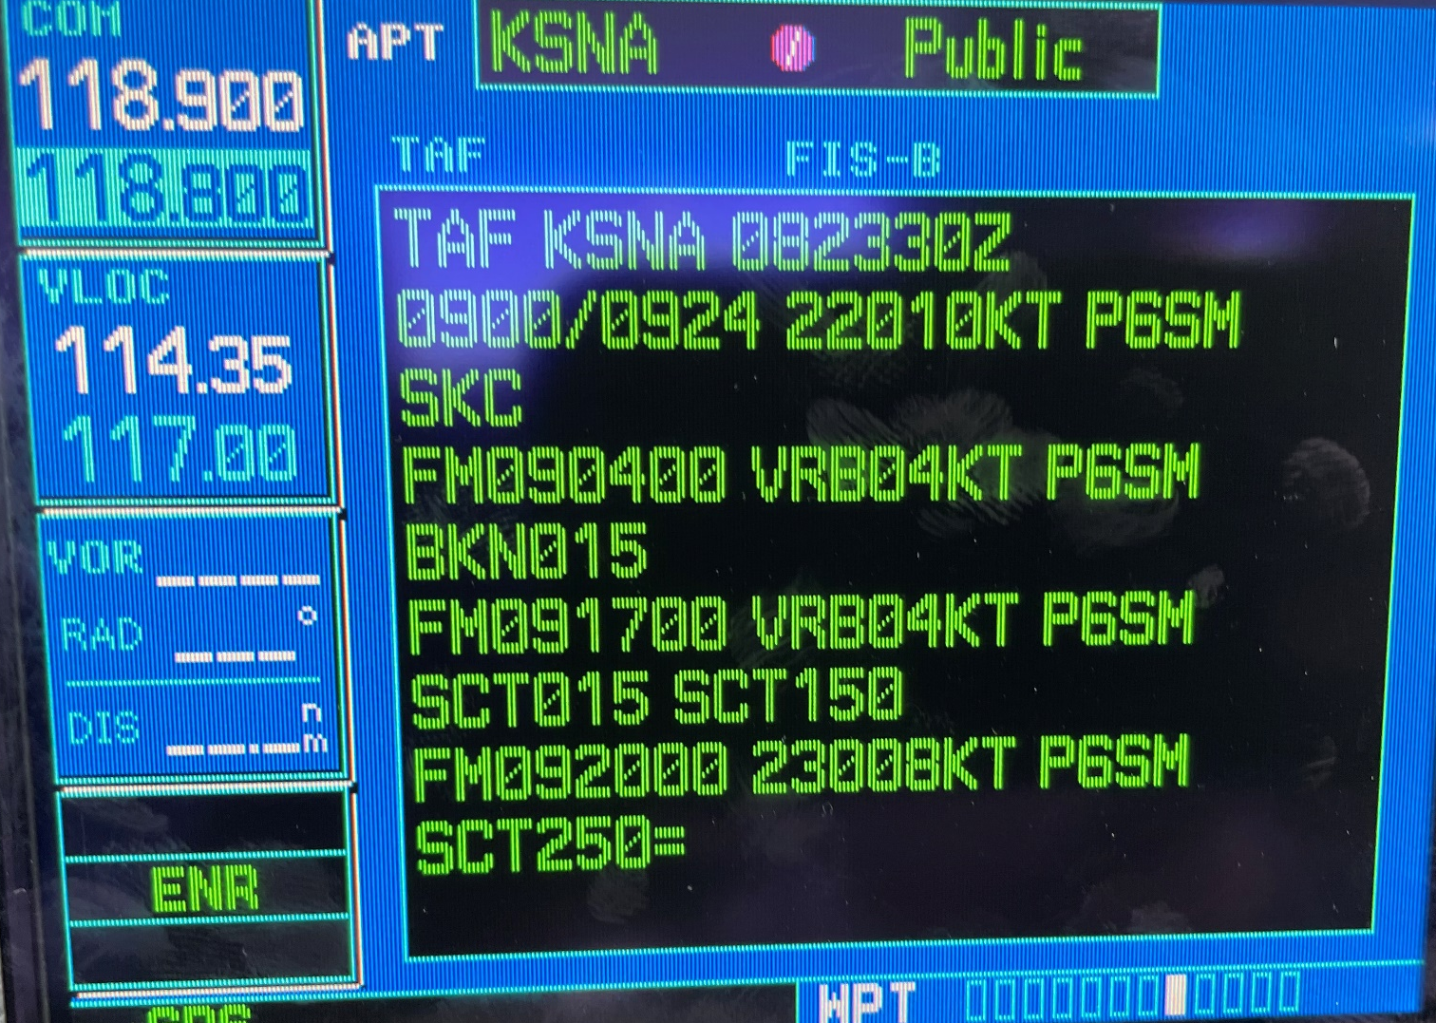
Onboard versus IRL
Notes:
Textual METAR and TAF info. Note: ATIS is not available, just the METAR and SPECI data. So, you still need to listen to the ATIS to get NOTAMs and Approach and Runway information.
(Next Slide)

Slide 35
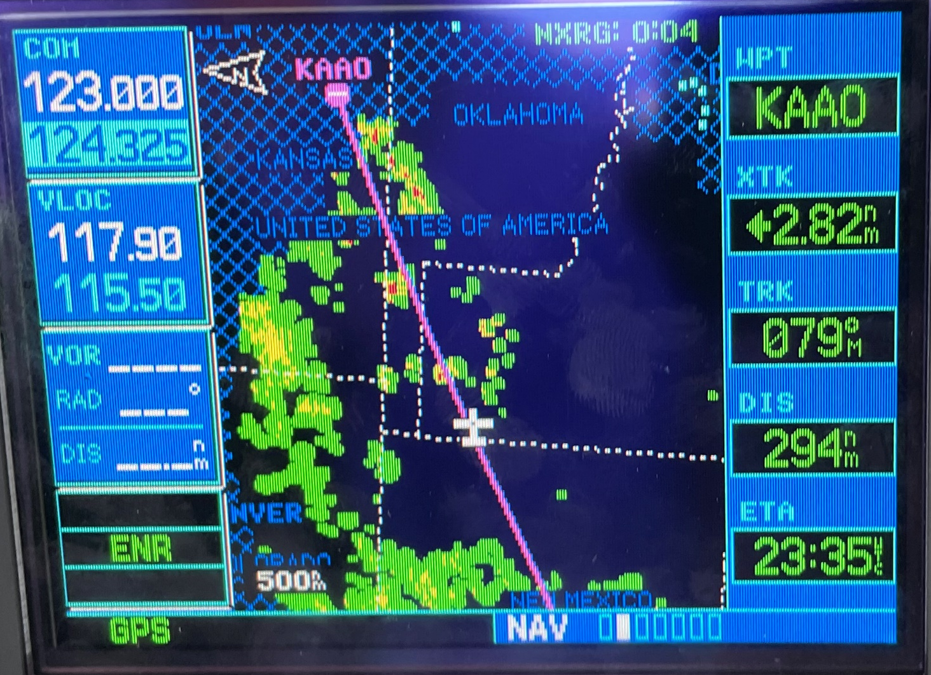
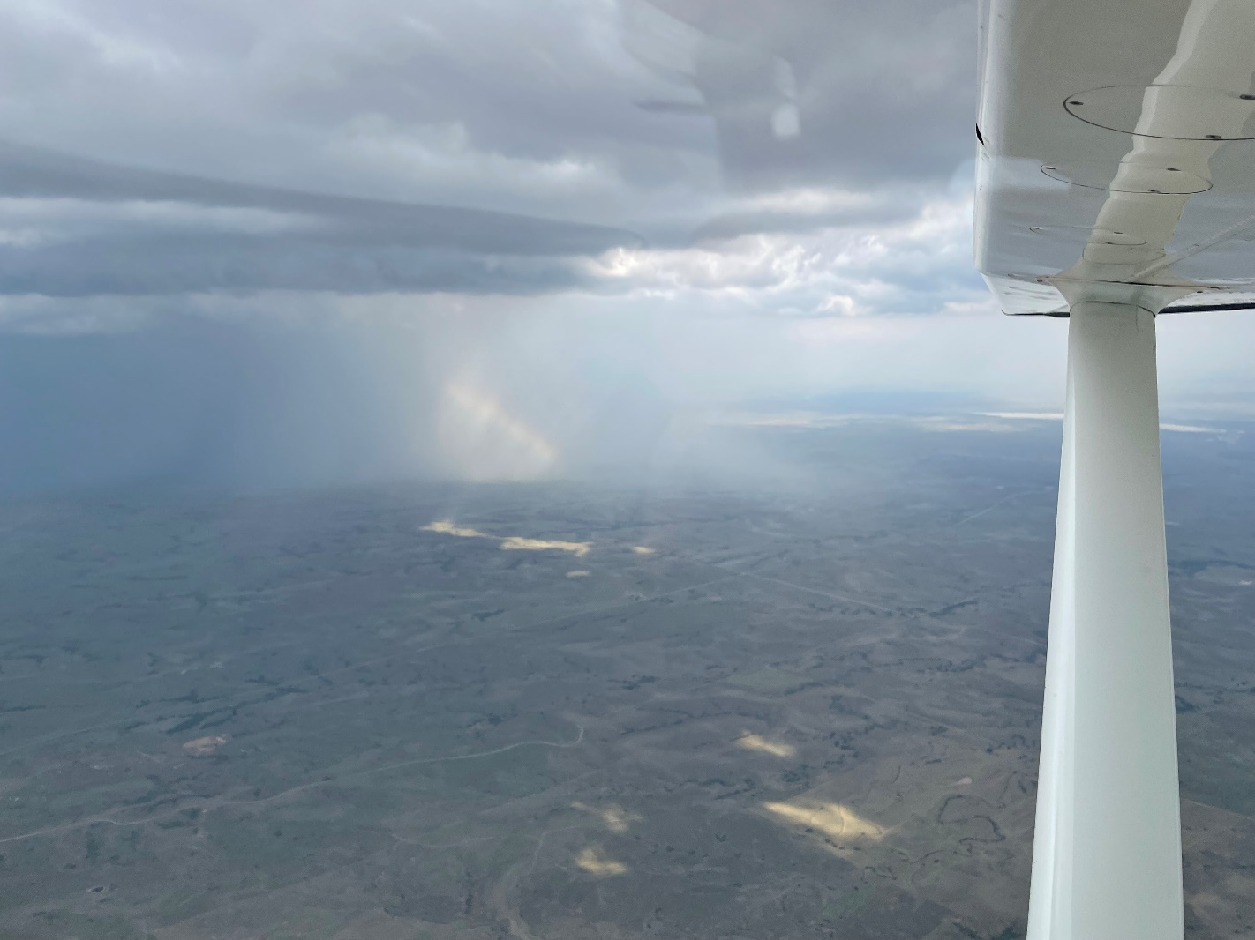
Onboard versus IRL
Notes:
Here’s an example taken from a GNS530W showing regional Nexrad data. Note the hashmarked areas beyond the range of current data. (Click)
For comparison, here’s an image taken out the window looking at the same weather. When flying near an area like this, I like to keep an eye on reported ceilings at nearby airports to ensure that I can stay well below those ceilings.
(Next Slide)

Slide 36
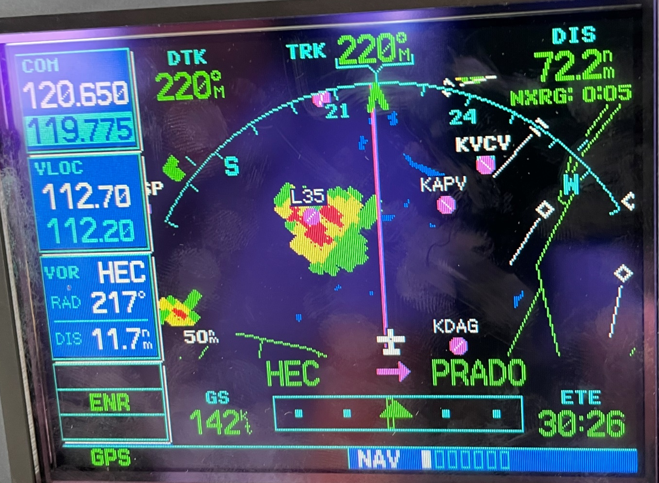
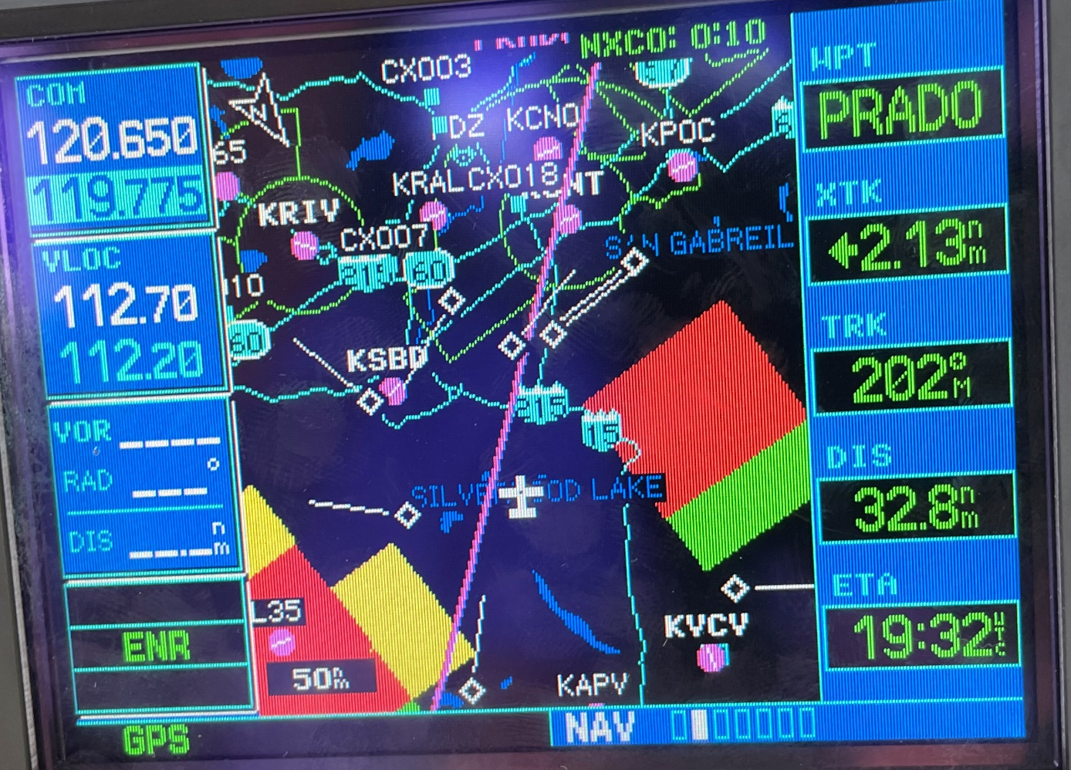
Onboard versus IRL
Notes:
Left is Regional Radar via ADS-B, Right is CONUS Radar.
Note the different ages: they are different data, and have a different transmit schedule. Regional is 150-250NM from the ADS-B transmitter site. It is higher resolution than the CONUS image. Both types of radar data are transmitted in “chunks”, and it will take several chunks to make a complete picture.
These are “composite” radar images. That is, a composite of the radar picture at all tilt angles. There is precipitation somewhere in that column of space; not necessarily all at one altitude. We have no control over the tilt angle or radar gain control, so we can’t really analyze that column of air from onboard.
Note the difference in “blockiness” between the two images. This illustrates the resolution difference between the two types of radar images.
Note the severe contouring… the transition from black (no return) through green and yellow to red, sometimes directly from black to red with no transition. This indicates extreme convection, and is to be avoided.
(Next Slide)

Slide 37
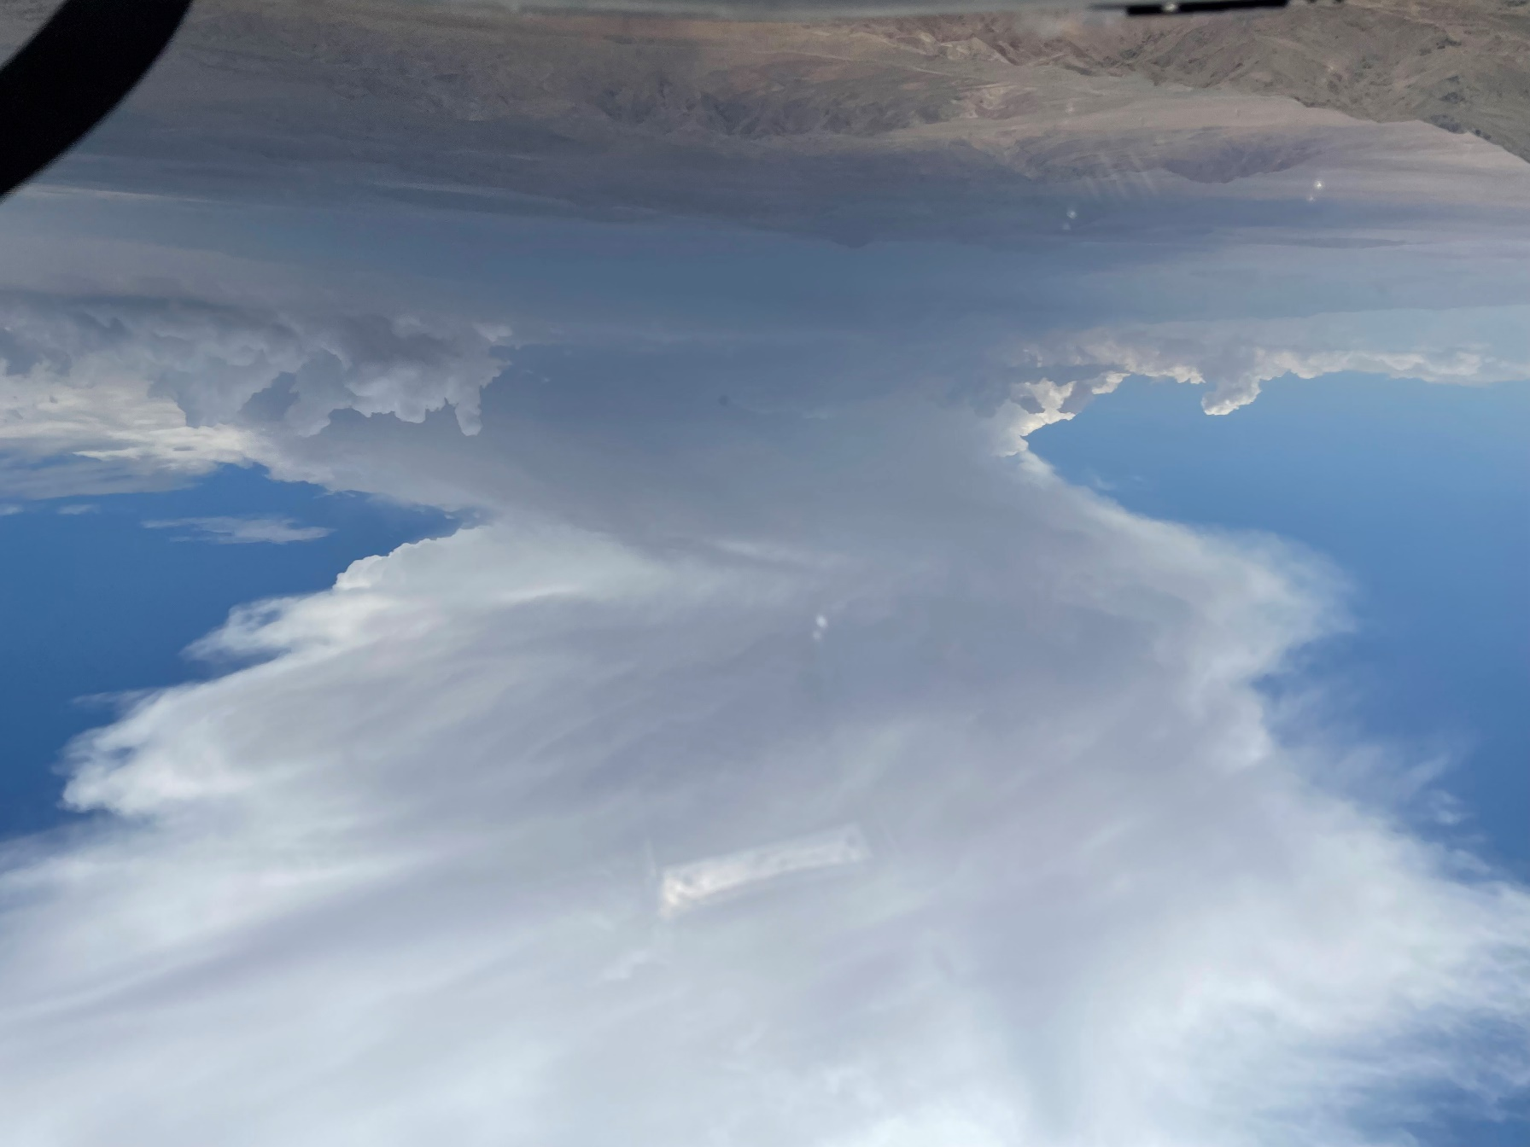
Onboard versus IRL
Notes:
This is the visual on the storm on the left of our track.
(Next Slide)

Slide 38

Notes:
This is the visual on the storm on the right of our track. Not nearly as scary as the CONUS image would have let us believe.
(Next Slide)

Slide 39
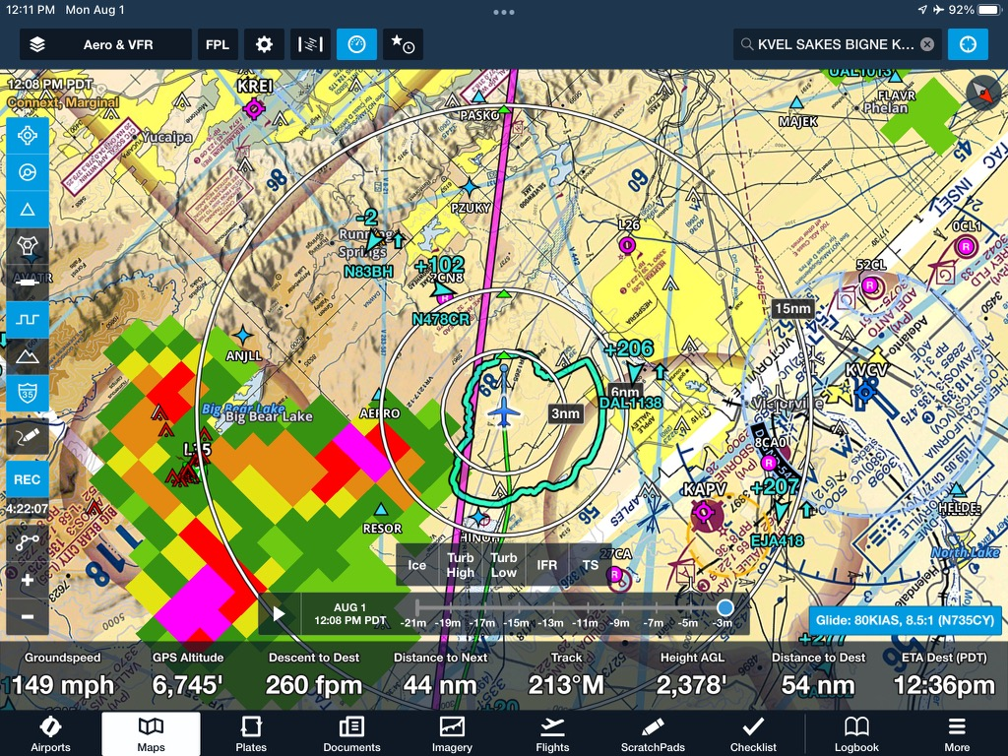
Notes:
iPad/FF Screenshot of the same weather. Note weather on the right is almost non existent, while we have heavy contouring over Big Bear, as we saw on the installed avionics as well as out the window.
(Next Slide)

Slide 40
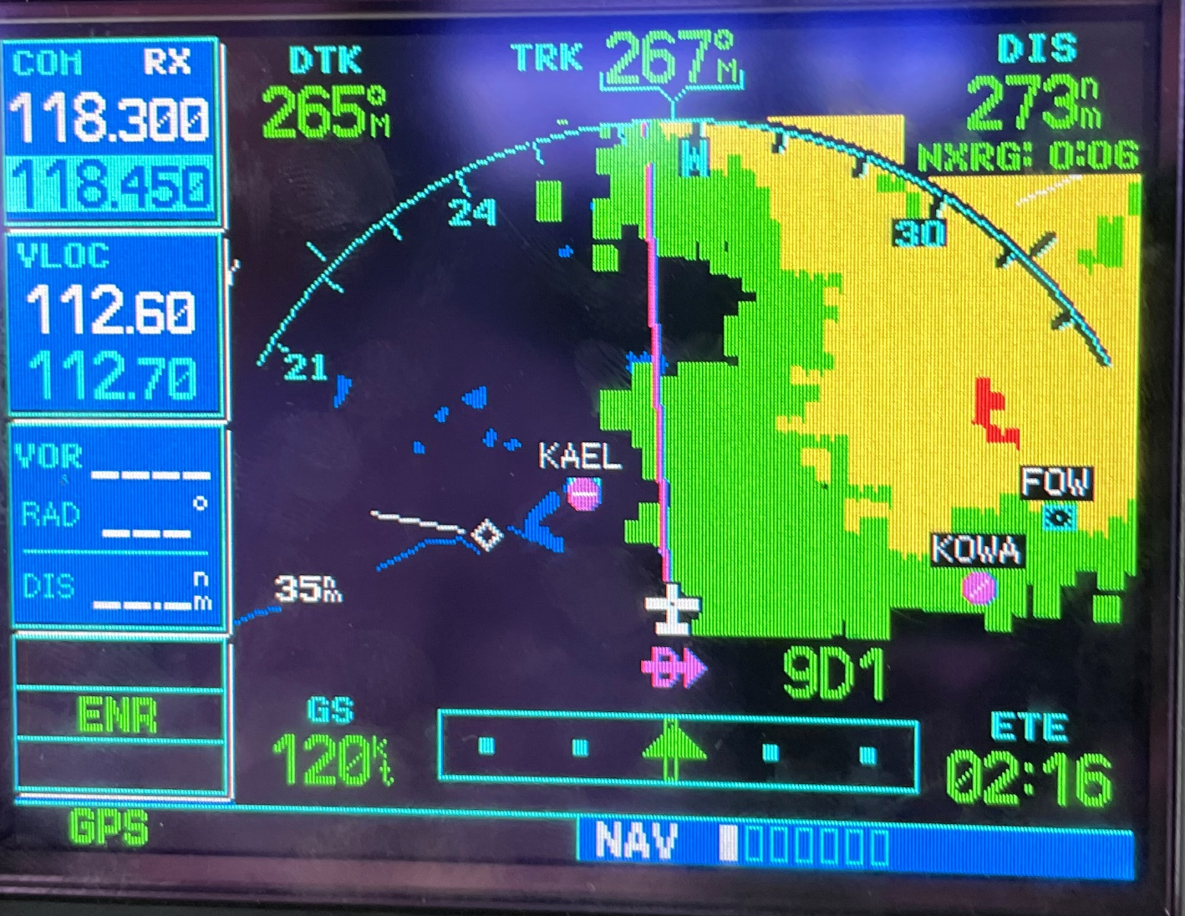
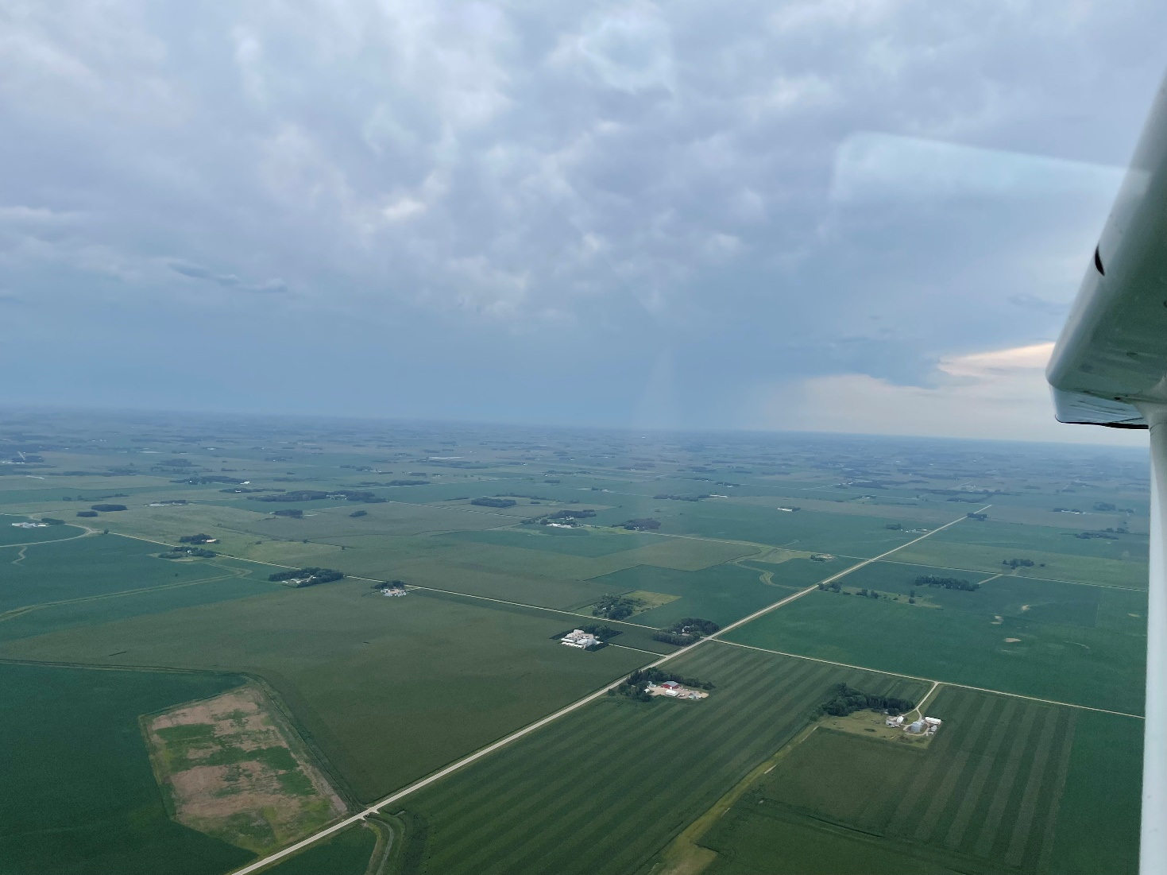
Onboard versus IRL
Notes:
Mild contouring… Notice wide swaths of green and yellow, with just a touch of red way away in the middle of it. This is not so bad to fly in.
I advise to stay underneath weather like this. If you get in it, it can easily outclimb you, you will lose site of it, and it’s easy to blunder in to heavier portions of the weather. If you stay underneath it, you can stay visual with it and deviate as necessary.
(Next Slide)

Slide 41
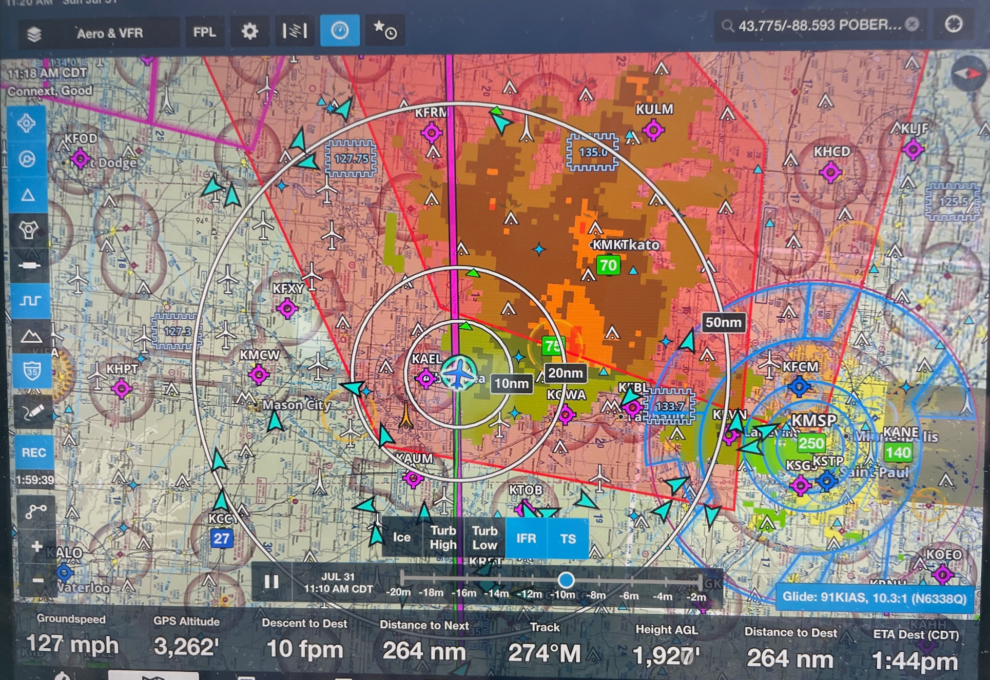
Notes:
ForeFlight screen shot, with IFR and Thunder Storm Sigmets overlaid with the radar. Note additional gradients of green.
(Next Slide)

Slide 42

Air Traffic Control
Limited ability and time to
forward weather information
You can learn a lot by
just listening.
Don’t wait until the last minute
to make diversion requests.
Notes:
Air traffic controllers are another in-flight weather information resource. They do have the ability to show weather on their displays but that capability is limited and when you most need information they may be
too busy – dealing with re routing requests – to provide it.
You can learn a lot by monitoring air traffic control frequencies though. You’ll hear what pilots are requesting and what ATC can provide. If you make your weather decisions with that in mind your requests are more likely to be granted.
Once again – don’t wait till the last minute to request a diversion. ATC needs some time to process your request.
(Next Slide)

Slide 43

Cautions & Tips
Don’t fixate on the equipment
  Cockpit displays don’t tell the whole story
    We still have to look outside
Understand what the displays tell you… and what they don’t.
  You may not see all the traffic in your area
  or all the weather ahead
Make weather avoidance decisions early
  Don’t wait till you’re close to choose a route
  Refine your decisions as more information
  becomes available
Notes:
In-cockpit information displays can be compelling distractions. Don’t fixate on the box to the exclusion of other flight management tasks. Cockpit displays – no matter how sophisticated and comprehensive they may be – don’t tell the whole story. A big part of our job is still looking out the window.
It’s important to thoroughly understand what the displays are telling you, and just as important, what they aren’t. Displays may not depict all the traffic in your area or all the weather ahead.
Generally speaking it’s best to make in-flight decisions early rather than waiting until the last minute to act. Landing to refuel is much less stressful if you have an hour or so of fuel remaining. Likewise rerouting or diversion is easier if you have some maneuvering room and time to select the best alternative.
By continuous reference to all weather resources available to you in the cockpit, you’ll have a comprehensive picture of the weather and any decisions will be well informed.
(Next Slide)

Slide 44
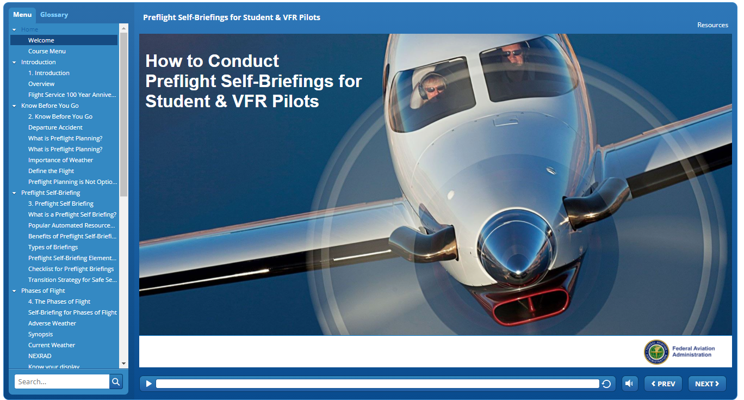

Want to know more?
https://bit.ly/3tmxtrX
Notes:
Accurate weather information is vitally important to all pilots. In this presentation we’ve told you what’s available in the way of weather info sources but we’ve said little about how to use them. For that we recommend FAAs new course – How to Conduct Preflight Self-Briefings for Student & VFR Pilots. The course is available on FAASafety.gov
(Next Slide)

Slide 45




Proficiency training works!
Sports
Medicine
Aviation
Notes:
Can you imagine how well professional athletes would perform if they didn’t practice between games or stay in shape during the off season? (Click)
Would you choose to be treated by doctors who had no continuing education since graduating from medical school? (Click)
Or how about a professional pilot flight crew who never train for emergencies?
Pros know that proficiency is not a destination but rather a journey that never ends.
Regular training keeps the them at peak performance every time they take to the air.
(Next Slide)

Slide 46


Proficiency Training Works
Increases confidence
Increases comfort
Expands horizons
Keeps us safe
Earning any WINGS phase qualifies for a Flight Review!
Notes:
Proficiency training works for General Aviation pilots too. Pilots who participate in the FAA WINGS Pilot Proficiency program fly with more confidence. They and their passengers are comfortable in the air. And proficiency training can expand our horizons by exploring the operational capabilities of our present aircraft or introducing us to more complex and capable planes as well as more challenging destinations.
Most importantly - proficiency training keeps us safe. (Click)
And pilots who earn WINGS phases also qualify for a flight review.
(Next Slide)

Slide 47

Why WINGS?
Proficient Pilots are:
  Confident
  Capable
  Safe
WINGS will keep you
on top of your game
Notes:
So why WINGS? Well proficiency is key to success in almost every thing worth doing – especially flying. Proficient pilots are confident, capable, and safe.
WINGS is a proficiency training system specifically designed for general aviation pilots and, regular participation will keep you on top of your flying game.
(Next Slide)

Slide 48
References
AC 00-63A Use of Flight Deck Displays of Digital Weather and Aeronautical Information
  https://www.faa.gov/documentLibrary/media/Advisory_Circular/AC_00-63A.pdf
AC 90-114B Automatic Dependent Surveillance-Broadcast Operations
  https://www.faa.gov/documentLibrary/media/Advisory_Circular/AC_90-114B.pdf
Notes:
Here are a few references for additional information:
I’ll leave this slide on screen while I take some questions from the audience.
AC 90-114B Automatic Dependent Surveillance-Broadcast Operations
AC 00-63A Use of Flight Deck Displays of Digital Weather and Aeronautical Information (This AC has a Change Revision CH2 coming out very shortly) This AC addresses both the Federal Aviation Administration (FAA) FIS–Broadcast (FIS-B) provided through the Automatic Dependent Surveillance–Broadcast (ADS-B) Universal Access Transceiver (UAT) network and non-FAA FIS systems provided through commercial data link services.
Presentation note: Take questions from the audience while they copy information from the screen. Then:
(Next Slide)

Slide 49
References
Aeronautical Information Manual
  https://www.faa.gov/air_traffic/publications/atpubs/aim_html/
  Chapter 7 – Safety of Flight
    Section 1 – Meteorology
  Chapter 4 – Air Traffic Control
    Section 1 – Services Available to Pilots – ADS-B
AC 91-92 Pilot’s Guide to a Preflight Briefing
  https://www.faa.gov/regulations_policies/advisory
  _circulars/index.cfm/go/document.information/document
  ID/1036892
Automated Surface Observing Systems
  https://www.weather.gov/asos/
  https://www.faa.gov/air_traffic/weather/asos/
Notes:
Here are a few references for additional information:
I’ll leave this slide on screen while I take some questions from the audience.
Presentation note: Take questions from the audience while they copy information from the screen. Then:
(Next Slide)

Slide 50
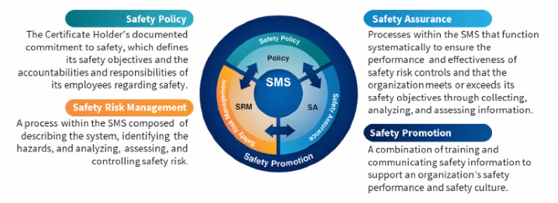


Safety Management Systems (SMS)
Coming to General Aviation
https://www.faa.gov/about/initiatives/sms
Notes:
Safety Management Systems are a set of policies and processes that can increase the safety and efficiency of any flight operation. And FAA is bringing SMS to General Aviation. You may have heard of SMS but thought it was only for large organizations but actually SMS can be scaled to fit any operation large or small.
There are 4 major components to a Safety Management System (Click)
Safety Policy – a documented commitment to safety that runs from the head of an organization to its newest member. (Click)
Safety Risk Management – a process that identifies hazards within an operation, determines to what extent an identified hazard may impact flight safety, and controls the risk of occurrence to an acceptable level. (Click)
Safety Assurance – By collecting and analyzing information derived from safety performance data Safety Assurance ensures the performance and effectiveness of Safety Risk Controls. (Click)
Safety Promotion communicates safety information and commitment throughout the organization. (Click)
You can find more information about Safety Management Systems at the URL on the Screen.
(End)

Slide 51

Questions?
Notes:
Presentation Note: You may wish to provide your contact information and main FSDO phone number here. You can also add WINGSPro contact information.
Modify with your information or leave blank.
(Next Slide)

Slide 52
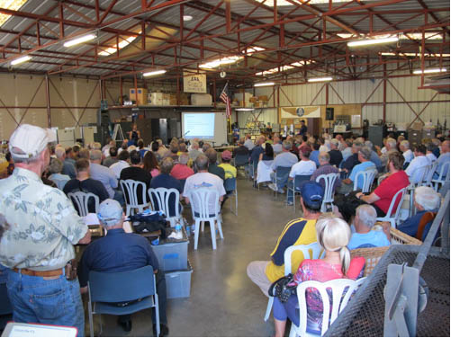
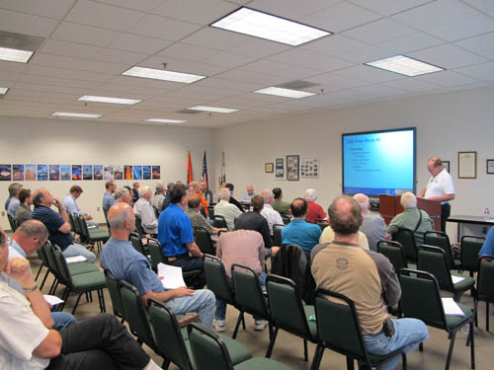
Thank you for attending
You are vital members of our GA safety community
Notes:
Your presence here shows that you are vital members of our General Aviation Safety Community. The high standards you keep and the examples you set are a great credit to you and to GA.
Thank you for attending.
(Next Slide)

Slide 53
The National FAA Safety Team Presents
Topic of the Month – August
Pre-flight & In-flight Weather Resources
Notes:
(The End)

